Slide 1
CM1605 Web Technology
HTML Forms
Week 4| Janani Harischandra

Slide 2
Learning Outcomes
Covers LO2 for Module
On completion of this lecture, students are expected to be able to:
Understand the concepts of HTML forms, form elements and form controls, HTML 5 form controls.
Describe how HTML forms work in hypertext documents.
Apply hypertext concepts to create HTML forms for a given context using different form controls, form elements using CSS.

Slide 3
Content
HTML Forms
How HTML Forms work
Form Elements
Form Controls
HTML 5 Form Controls
CSS with Forms

Slide 4
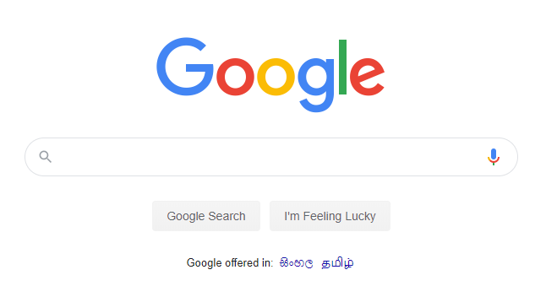
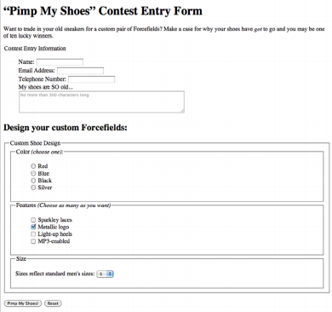
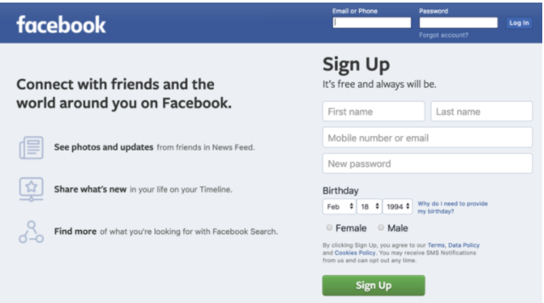
Forms

Slide 5
HTML Forms
Forms are used to create (rather primitive) GUIs on Web pages.
Forms are added to web pages using the form element.
The form element is a container for
Form controls (radio buttons, checkboxes, text inputs etc)
Text and other elements
Block elements (h1, p, list)
HTML Markup :<form parameters> ….form elements… </form>.

Slide 6
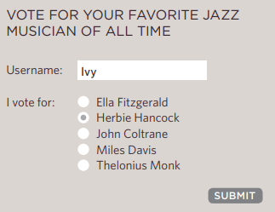


How HTML forms work?
Data
Name :Ivy
Vote :Herbie Hancock
There are two parts to a working form.
HTML Markup in the web page
Application or script on the server that processes the information collected by the form and returns an appropriate response.
The server processes the information using a programming language such as PHP, C#, VB.net, or Java
The server creates a new page to send back to the browser based on the information received.

Slide 7
HTML form arguments
Argument | Usage
action="url” (required) | Provides the location (URL) of the application or script (sometimes called the action page) that will be used to process the form. Eg: <form action=“/index.php”>…..</form> Send the form content to a email Eg:<form action=“mailto:Janani.h@iit.ac.lk”>…..</form>
method="get” (default) method="post" | Specifies how the information should be sent to the server. GET and POST method can be used to transfer data.
target=“_blank" | Tells where to open the page sent as a result of the request target= _blank means open in a new window target= _top means use the same window

Slide 8
Form Controls
Adding Text
Text inputs
Password inputs
Text area
Specialized text entry fields (tel, url, email, search) -> New in HTML 5
Making Choices
Radio buttons
Checkboxes
Drop down boxes
Data List
File uploading
Buttons
Submit/Reset Buttons
Image Buttons

Slide 9
GET Method
With the GET method, the encoded form data gets tacked right onto the URL sent to the server.
A question mark character separates the URL from the following data, as shown here:
Eg: get http://www.bandname.com/cgi-bin/mailinglist.pl?name=Sally%20Strongar m&email=strongarm%40example.com
When to use?
Appropriate if you want users to be able to bookmark the results of a form submission
not appropriate for forms with private personal or financial information
GET may not be used when the form is used to upload a file.

Slide 10

POST Method
With POST method, the browser sends a separate server request containing some special headers followed by the data.
Only the server sees the content of this request
https://www.w3schools.com/tags/tryit.asp?filename=tryhtml_form_method
When to use?
it is the best method for sending secure information such as credit card or other personal information.
Preferable for sending a lot of data, such as a lengthy text entry

Slide 11
<input> Tag
<input> element is used to create several different form controls.
Most, but not all, form elements use the <input> tag.
<input> type many arguments.
Argument | Purpose
type | type can be text, checkbox, radio, password, hidden, submit, reset, button, file, or image
name | the name of the element
Id | A unique identifier for the element
value | The value attribute specifies default text that appears in the field when the form is loaded
max length | You can set a maximum character limit using the maxlength attribute
readonly | the value cannot be changed
Disabled | the user can’t do anything with this element

Slide 12



Text Input Examples
HTML Markup | Formatted Text
<input type="text" name="textfield" value="with an initial value" />
<textarea name="textarea" cols="24“ rows="2">Hello</textarea>
<input type="password" name="textfield3" value="secret" />
Name – Used to access element in Javascript.
Placeholder – use to display help text inside.
maxLength – Limit Number of characters.
Required – makes the text box input mandotory
Note that two of these use the input tag, but one uses textarea.

Slide 13
Buttons
HTML Markup | Formatted Text
A submit button: <input type="submit" name="Submit" value="Submit" />
A reset button: <input type="reset" name="Submit2" value="Reset" />
submit: send data
reset: restore all form elements to their initial state
button: take some action as specified by JavaScript will be discussed in Lecture 8.

Slide 14
More Buttons
HTML Markup | Formatted Text | Usage
A plain button: <input type="button" name="Submit3" value="Push
Button Elements: <button type="button" onclick="alert('Hello world!')">Click Me!</button> |  | Inside a <button> element you can put text (and tags like <i>, <strong>, <br>, <img>, etc.). This is not possible with a button created with the <input> element!
These two types of button will have no default behaviour, other than being a clickable button, and you will need to add some JavaScript to add event listeners to these buttons and add behaviour (for example calculating the total price of an order).

Slide 15
Labels
In many cases, the labels for controls are not part of the control.
Eg:<input type="radio" name="gender" value="m" />male
The label element associates descriptive text with its respective form field.
Each label element is associated with exactly one form control.
Eg: <label><input type="radio" name="gender" value="m" />male</label>
Proper use of labels with the elements above will benefit:
Screen reader users (will read out loud the label, when the user is focused on the element)
Users who have difficulty clicking on very small regions (such as checkboxes) - because when a user clicks the text within the <label> element, it toggles the input (this increases the hit area).

Slide 16
Labels
There are two ways to use it.
Method 2 – Improves Forms Accessibility -> More on Lecture 10
Method | HTML Markup
1 | Implicit label: <label><input type="radio" name="gender" value="m" />male</label>
2 | Explicit label: <label for="form-login-username">Login account</label> <input type="text" name="login" id="form-login-username"> <label for="form-login-password">Password</label> <input type="password" name="password" id="form-login-password">

Slide 17

Radio Buttons
Syntax - <input type="radio" name="variable" value="value">
The name attribute is required and plays an important role in binding multiple radio inputs into set.
If two or more radio buttons have the same name, the user can only select one of them at a time
This is how you make a radio button “group”
If you ask for the value of that name, you will get the value specified for the selected radio button.
HTML Markup | Formatted Text
Radio buttons:<br> <label for=“male">Male</label> <input type="radio" name=“gender" value="male“ id=“male”/> male<br> <label for=“female">Female</label> <input type="radio" name=“gender" value=“female” checked="checked“ id=“female”/> female

Slide 18
Checkboxes
Syntax - <input type=“checkbox">
Checkboxes don’t necessarily need to be used in groups, of course.
The difference, as we’ve already noted, is that more than one checkbox may be checked at a time.
HTML Markup | Formatted Text
A checkbox: <input type="checkbox" name="checkbox" value="checkbox" checked="checked">
type: "checkbox"
name: used to reference this form element from JavaScript
value: value to be returned when element is checked
Note that there is no text associated with the checkbox
Unless you use a label tag, only clicking on the box itself has any effect

Slide 19


Menus
Drop-down/pop up menus
<select name="select"> <option value="red">red</option> <option value="green">green</option> <option value="BLUE">blue</option> </select>
Additional arguments:
size: the number of items visible in the list (default is "1")
multiple
if set to "true" (or just about anything else), any number of items may be selected
if omitted, only one item may be selected
if set to "false", behavior depends on the particular browser
Scrolling menus
<select name="EightiesBands" size="6" multiple>
<option>The Cure</option>
<option>Cocteau Twins</option>
<option selected>Tears for Fears</option>
<option selected>Thompson Twins</option>
<option value="EBTG">Everything But the Girl</option>
<option>Depeche Mode</option>
</select>
The optional SIZE attribute defines the size of the displayed list.
If the specified SIZE is smaller than the number of "OPTION" items, a vertical scroll bar will automatically be displayed, to allow the user to view all the different items.

Slide 20
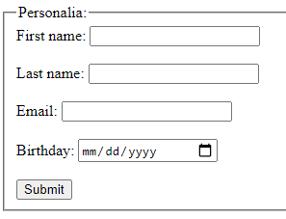
Fieldset and Legend
The fieldset element indicates a logical group of form controls.
The <fieldset> tag draws a box around the related elements.
A fieldset may also include a legend element that provides a caption for the enclosed fields.
The <legend> tag defines a caption for the <fieldset> element.
HTML Markup | Formatted Text
<form action=""> <fieldset> <legend>Personalia:</legend> <label for="fname">First name:</label> <input type="text" id="fname" name="fname"><br><br> <label for="lname">Last name:</label> <input type="text" id="lname" name="lname"><br><br> <label for="birthday">Birthday:</label> <input type="date" id="birthday" name="birthday"><br><br> <input type="submit" value="Submit"> </fieldset> </form>

Slide 21
Hidden Fields
There may be times when you need to send information to the form processing application that does not come from the user.
In these instances, you can use a hidden form control that sends data when the form is submitted, but is not visible when the form is displayed in a browser.
Eg: <input type="hidden" name="success-link" value="http://www.example.com/littlechair_thankyou.html">
The value of a hidden field can be set programmatically (by JavaScript) before the form is submitted.

Slide 22
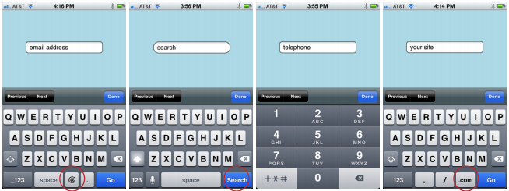
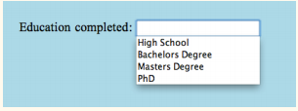
HTML 5 Text Inputs
HTML Markup | Formatted Text
<input type="search">
<input type="email">
<input type=“tel">
<input type=“url">
<label for="edulevel">Education Completed:</label> <input list="edulevel" name="edulevel" id="edulevel"><datalist id="edulevel"> <option value="High School"> <option value="Bachelors Degree"> <option value="Masters Degree"> </datalist>
The datalist element (new in HTML5) allows the author to provide a drop-down menu of suggested values for any type of text input.

Slide 23
What is new with HTML 5 form elements?
Browsers that support this HTML 5 form elements will automatically check the validity of the format of the data entered and alert the user if the format is invalid.
Eg:email, tel, number, url, date, week, datetime-local
If the browser doesn't support this input type, it will automatically fall back to the type="text"

Slide 24
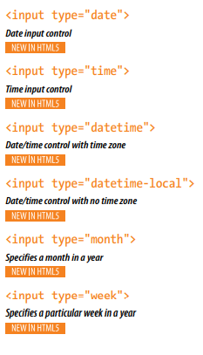
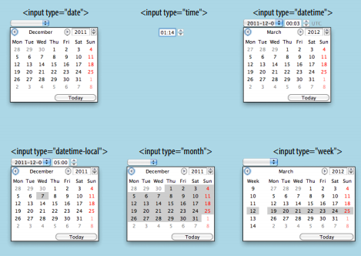
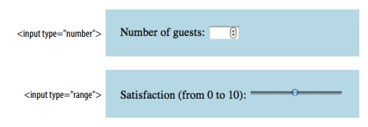
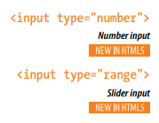
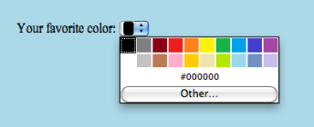

HTML 5 New Additions

Slide 25
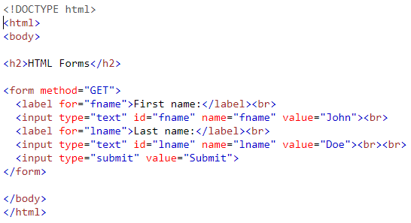
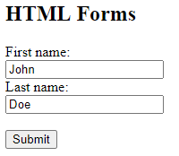
Form Example

Slide 26
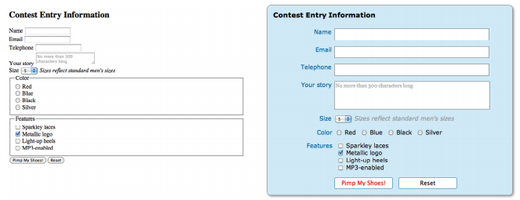
CSS with Forms
Adding basic styles
Aligning labels and inputs/form elements
Adjusting buttons
Forms tend to be ugly and difficult to use with HTML alone (left). A little CSS can make a big difference (right)

Slide 27
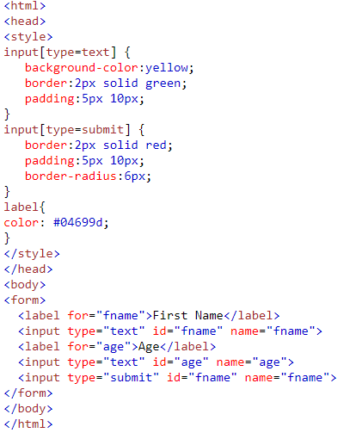
CSS with Forms

Slide 28
Reading
Duckett, J. (2011), HTML & CSS, Design and Build Websites, Wiley.
Robbinson, J . (2018), Learning Web Design, A Beginner’s Guide to HTML,CSS, JavaScript, And Web Graphics, O’Reilly.
Castro & Hyslop, B.(2011), HTML5&CSS: Visual QuickStart Guide, Peachpit Press.
Online :
https://www.w3schools.com/html/html_forms.asp

